Slide 1
Security Protocols
Dr. Qinke
Associate Professor
qinke@uestc.edu.cn
Main Building: A2-301B
http://www.qinkesci.cn

Slide 2
Resume (Education)
Master in Computer Science, June 2006
UESTC
Ph.D. in Computer Science, June 2010
UESTC
Visiting Scholar at
Carleton University (2008.01-2008.12)
University of California, Santa Barbara (2016.09-2017.02)

Slide 3
Resume(Work)
Assistant lecturer at UESTC (2006.04-2018.12)
Lecturer at UESTC (2009.01-2012.07)
Associate Professor at UESTC (2012.08-Current)
Research Interest:
Information Security
Neural Networks
Big Data

Slide 4
Make yourself known to me…
Name
Photo
What do you want to learn from this course?
Any ideas about this course?

Slide 5
Contents
Chapter I. Foundations
Chapter II. Protocol Building Blocks
Chapter III. Basic Protocols
Chapter IV. Intermediate Protocols
Chapter V. Advanced Protocols
Chapter VI. Esoteric Protocols

Slide 6
Chapter I. Foundations

Slide 7
Chapter I. Foundations
Math Background
Terminology
Classical ciphers
Exclusive OR
One-time pad
Large numbers

Slide 8
Terminology
Sender <-> Receiver
Send and receive securely
Make sure an eavesdropper cannot read message
Messages and Encryption
Plaintext
Ciphertext
Decryption and Encryption

Slide 9
Terminology
Receiver
Sender
Encryption
Decryption
Plaintext
Hello, world
Ciphertext
!@#$%^&**(
Plaintext
Hello, world
Encryption: E(m,k)=c
Decryption: D(c,k)=m
D(E(m,k),k)=m

Slide 10
Terminology
Authentication
It should be possible for the receiver of a message to ascertain its origin;
an intruder should not be able to masquerade as someone else.
Integrity
It should be possible for the receiver of a message to verify that it has not been modified in transit; an intruder should not be able to substitute a false message for a legitimate one.

Slide 11
Terminology
Nonrepudiation
A sender should not be able to falsely deny later that he sent a message
Confidentiality
Nobody else can read the special message

Slide 12
Terminology
Algorithms and keys
A cryptographic algorithm, also called a cipher, is the mathematical function used for encryption and decryption.
Restricted algorithm
If the security of an algorithm is based on keeping the way that algorithm works a secret
Is it secure?
Encryption: E(m,k1)=c
Decryption: D(c,k2)=m
D(E(m,k1),k2)=m

Slide 13
Terminology
Cryptosystem
Plaintext space
Ciphertext space
Key space
Encryption
Decryption

Slide 14
Terminology
Symmetric algorithm
encryption key can be calculated from the decryption key and vice versa
Usually, they are the same thing.
Asymmetric algorithm
encryption key can NOT be calculated from the decryption key and vice versa.

Slide 15
Terminology
Symmetric algorithm
Stream algorithm / stream cipher
Block algorithm / block cipher
Asymmetric algorithm (public key algorithm)
Public key
Private key

Slide 16
Terminology
Cryptanalysis
Assumption: The cryptanalyst has complete details of the cryptographic algorithm and implementation.
General types for cryptanalysis attack
Ciphertext-only
Known-plaintext
Chosen-plaintext
Adaptive-chosen-plaintext
Chosen-cipher
Chosen-key
Rubber-hose

Slide 17
Terminology
Ciphertext-only
The cryptanalyst has the ciphertext of several messages, all of which have been encrypted using the same encryption algorithm.
The cryptanalyst’s job is to recover the plaintext of as many messages as possible, or better yet to deduce the key (or keys) used to encrypt the messages, in order to decrypt other messages encrypted with the same keys.

Slide 18
Terminology
Known-plaintext
The cryptanalyst has access not only to the ciphertext of several messages, but also to the plaintext of those messages.
His job is to deduce the key (or keys) used to encrypt the messages or an algorithm to decrypt any new messages encrypted with the same key (or keys).

Slide 19
Terminology
Chosen-plaintext
The cryptanalyst not only has access to the ciphertext and associated plaintext for several messages, but he also chooses the plaintext that gets encrypted.
This is more powerful than a known-plaintext attack, because the cryptanalyst can choose specific plaintext blocks to encrypt, ones that might yield more information about the key.
His job is to deduce the key (or keys) used to encrypt the messages or an algorithm to decrypt any new messages encrypted with the same key (or keys).

Slide 20
Terminology
Adaptive-chosen-plaintext
The cryptanalyst not only can the cryptanalyst choose the plaintext that is encrypted, but he can also modify his choice based on the results of previous encryption.
In a chosen-plaintext attack, a cryptanalyst might just be able to choose one large block of plaintext to be encrypted;
in an adaptive-chosen-plaintext attack he can choose a smaller block of plaintext and then choose another based on the results of the first, and so forth.

Slide 21
Terminology
Chosen-ciphertext
The cryptanalyst can choose different ciphertexts to be decrypted and has access to the decrypted plaintext.
For example, the cryptanalyst has access to a tamperproof box that does automatic decryption. His job is to deduce the key.
This attack is primarily applicable to public-key algorithms

Slide 22
Terminology
Chosen-key
This attack doesn’t mean that the cryptanalyst can choose the key; it means that he has some knowledge about the relationship between different keys.
Rubber-hose cryptanalysis
The cryptanalyst threatens, blackmails, or tortures someone until they give him the key.
Bribery is sometimes referred to as a purchase-key attack.
These are all very powerful attacks and often the best way to break an algorithm.

Slide 23
Terminology
Security of algorithms
Total break
A cryptanalyst finds the key, K, such that D (C, K ) = P.
Global deduction
cryptanalyst finds an alternate algorithm, A, equivalent to D (C, K )=P without knowing K.
Instance deduction
A cryptanalyst finds the plaintext of an intercepted ciphertext
Information deduction
A cryptanalyst gains some information about the key or plaintext

Slide 24
Terminology
unconditionally secure
if, no matter how much ciphertext a cryptanalyst has, there is not enough information to recover the plaintext.
In point of fact, only a one-time pad is unbreakable given infinite resources. All other cryptosystems are breakable in a ciphertext-only attack, simply by trying every possible key one by one and checking whether the resulting plaintext is meaningful.
This is called a brute-force attack

Slide 25
Terminology
computationally secure
if it cannot be broken with available resources, either current or future
Complexity measurement
Data complexity.
The amount of data needed as input to the attack.
Processing complexity.
The time needed to perform the attack.
Storage requirements.
The amount of memory needed to do the attack

Slide 26
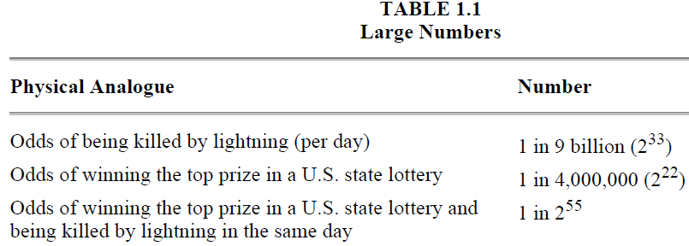
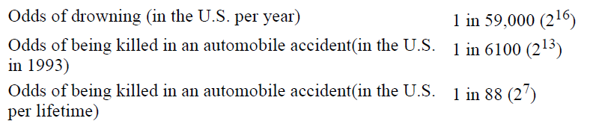
Large numbers

Slide 27
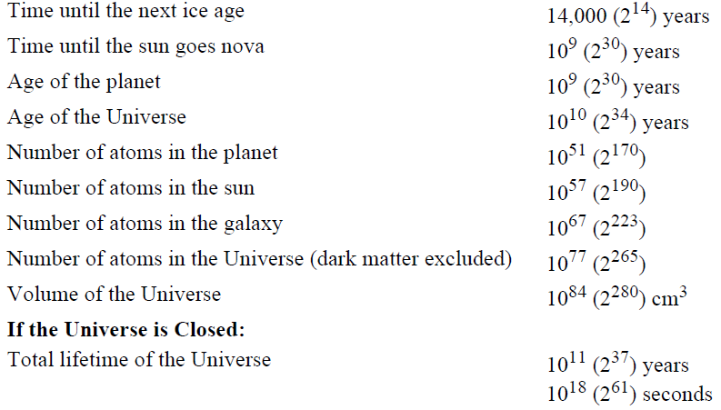
Large numbers

Slide 28
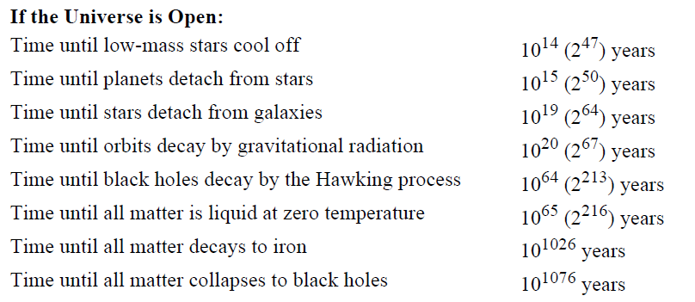
Large numbers

Slide 29
Classical cipher
Substitution cipher
Simple substitution cipher / Monoalphabetic cipher
each character of the plaintext is replaced with a corresponding character of ciphertext.
Homophonic substitution cipher
It is like a simple substitution cryptosystem, except a single character of plaintext can map to one of several characters of ciphertext
Polygram substitution cipher
Polyalphabetic substitution cipher

Slide 30
Classical cipher
Substitution cipher
Polygram substitution cipher
blocks of characters are encrypted in groups.
e.g. "ABA" could correspond to "RTQ," "ABB" could correspond to "SLL,“ and so on.
Polyalphabetic substitution cipher
It is made up of multiple simple substitution ciphers.
e.g. Vigenère cipher

Slide 31
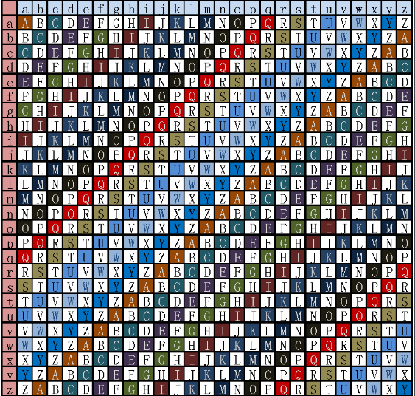

Slide 32
Classical cipher
Transposition cipher
The plaintext remains the same, but the order of characters is shuffled around
Example 1：
Plain: SIMPLE CIPHER
Cipher: REHPIC ELPMIS
Example 2：
Plain: S M L C P E
I P E I H R
Cipher: SMLCPEIPEIHR

Slide 33
Exclusive OR
0 ⊕ 0 = 0
0 ⊕ 1 = 1
1 ⊕ 0 = 1
1 ⊕ 1 = 0
Also note that:
a ⊕ a = 0
a ⊕ b ⊕ b = a

Slide 34
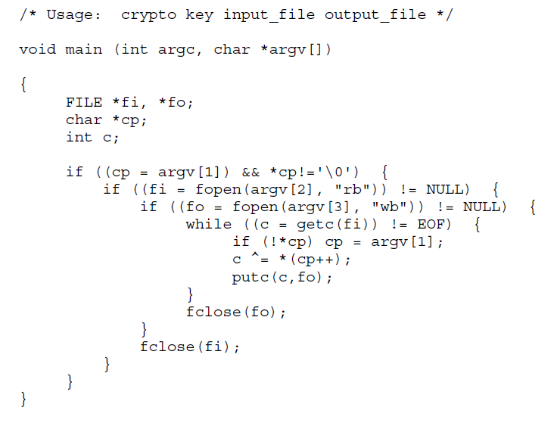
A cipher example

Slide 35
One-time Pads
Each key letter is used exactly once, for only one message
The sender encrypts the message and then destroys the used pages of the pad or used section of the tape.
The receiver has an identical pad and uses each key on the pad, in turn, to decrypt each letter of the ciphertext. The receiver destroys the same pad pages or tape section after decrypting the message.

Slide 36
One-time Pads
For example:
Plaintext is: ONETIMEPAD
Key sequence: TBFRGFARFM
What is the ciphertext?

Slide 37
One-time Pads
It is a perfect encryption scheme
It sounds good, but are there any problems?
The key bits must be random and can never be used again
The length of the key sequence must be equal to the length of the message
It is suitable for a few short messages, but not for long messages.

